Slide 1
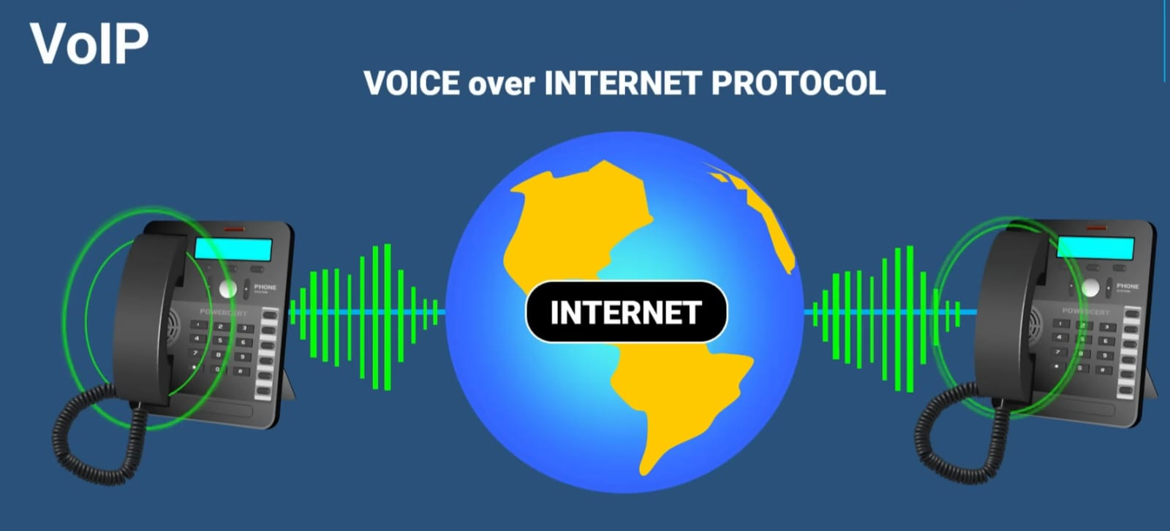
Innovative decisions

Slide 2
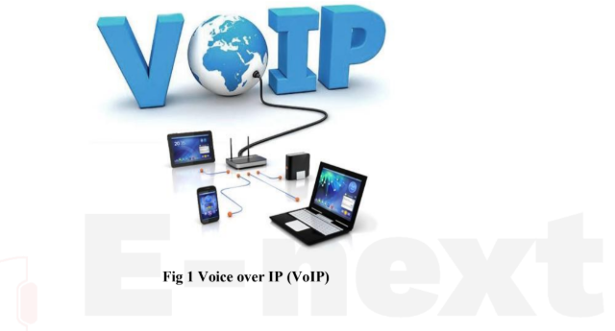
VOIP COMPONENT
VoIP is a communication technology that enables voice calls to be transmitted over IP-based networks like the Internet.

Slide 3
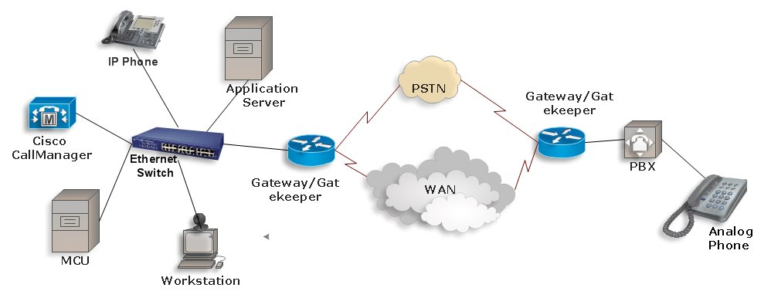

Slide 4
Five Major VoIP Network Components
MCUs
IP Network
Call Control
Voice and Media Gateways
User End Devices

Slide 5

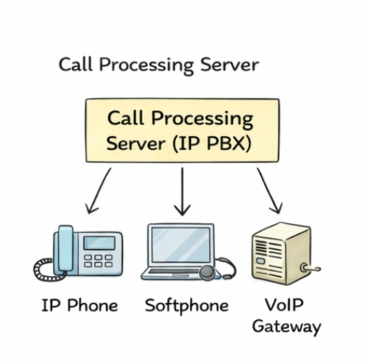
Call Control:
Call Control is the brain of a VoIP system.
It manages call setup, call ending, and signaling.
It can be software, hardware, or a soft switch.
It is easy to manage and secure compared to other components.
In hosted VoIP systems, provider security should be reviewed.

Slide 6
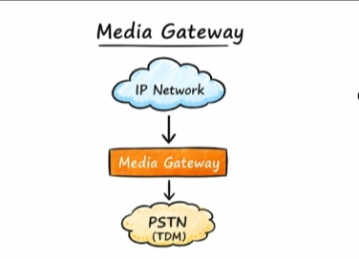
Voice and Media Gateways:
The voice or media gateway connects the VoIP network to external networks such as the Public Switched Telephone Network (PSTN).
Connect VoIP networks to the PSTN
Convert voice between TDM and IP formats
The media gateway transports voice traffic over the IP network.
Enable external call termination and media handling

Slide 7
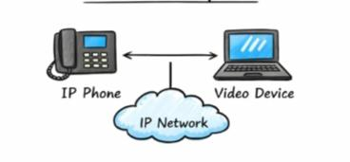
IP Network
This is the network that carries voice and signaling data.
Voice Transmission:
Voice is broken into packets
Packets are transmitted using RTP (Real-Time Transport Protocol) over UDP
Voice traffic needs priority over data traffic
QoS (Quality of Service) ensures clear voice calls

Slide 8
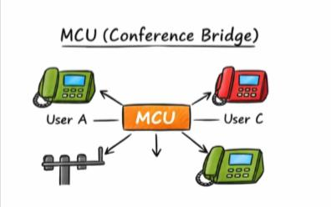
MCU (Multipoint Control Unit):
Used for audio and video conferencing
Also called conference bridges
Connect multiple users in one session
Can be hosted internally or externally
Security is critical because one failure affects many users
Must secure all connected media types

Slide 9
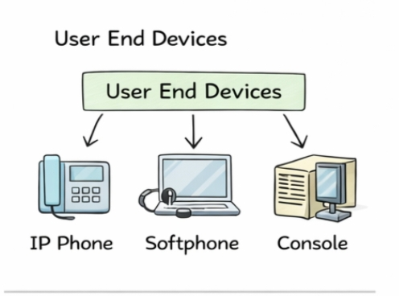
User End Devices
These are the devices used by users to make or receive calls.
Use TCP/IP protocol
Get IP address using DHCP
Communicate with the call processing server
User End Devices:
Types of End Devices:
VoIP Phones: Hardware phones that connect to IP network
Softphones: Software-based phones on laptops or PCs
Consoles: Special-purpose systems used in controlled environments

